Slide 1
title

Slide 2
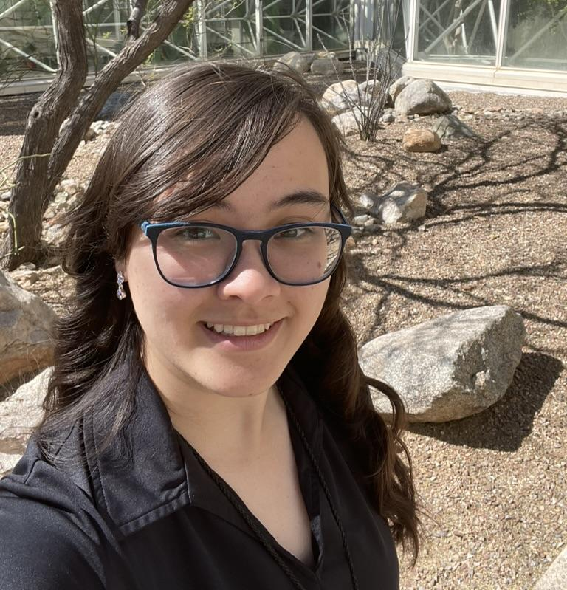
Meet our Team
Sean DuBois
Megan Zhang
Zhanel Amralina
Jake Whiting
Jordan Mars

Slide 3
Blot-situation recommendation
Aging, disconnected systems are becoming less reliable causing patients, clinicians, and revenue to suffer.

Slide 4
Agenda
1
BLOT
4
Background
2
Agenda
5
Analysis
3
Meet the Team
6
Recommendation

Slide 5
CanyonCare's Systems Were Never
Built To Work Together
1.1M
38
8
home visits a year
branches in AZ and NM
separate systems,
4 - 12 years old
CareSched (Scheduling)
RevSure (Billing)
11 years old; vendor support ends in 20 months
12 years old; vendor support ends in 28 months

Slide 6
Reliability is Failing
While Visits are Increasing
Scheduling severity - 2+ incidents
Mobile outage minutes
7 → 15
84 → 198
+114%
+136%
Calls per 1,000 visits
First-pass clean claims (target ≥96%)
46 → 68
95.1% → 94.0%
+48%
Visits only increased 11%
31% of calls need 3+ systems
62% of clinicians re-enter data weekly

Slide 7
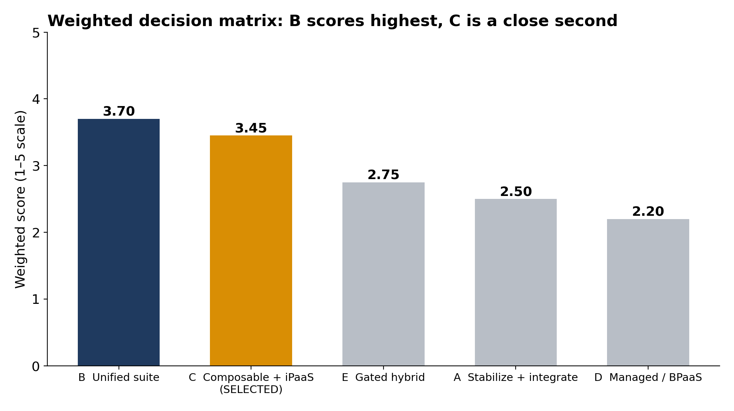
Analysis 1

Slide 8
Analysis 2
Both B and C fix fragmentation and cost about the same over 5 years ($12M). The difference is risk.
Option B: Unified cloud suite
Option C: Composable (our pick)
Makes 5 risks worse:
Mobile sync
Business continuity
Change adoption
Revenue cycle
Vendor lock-in
2 risks: privacy, governance drift
Keeps the apps clinicians already use Replaces systems one at a time
Moderate confidence + month-12 gate
C fixes the problem without putting a single home visit at risk.

Slide 9
Recommendation
Implement the Composable Platform and modernize the iPaaS and API.

Slide 10
Thank you
Questions?

Slide 11
Index

Slide 12
Current System Landscape Between Nov 2025 and Oct 2026
Metric | Nov 2025 → Oct 2026 | Change
Completed visits | 88,700 → 98,100 | +11%
Scheduling severity- 2+ incidents | 7 → 15 | +114%
Mobile outage minutes | 84 → 198 | +136%
Failed interface jobs | 420 → 684 | +63%
Potential duplicate-patient events | 74 → 129 | +74%
Identity/access tickets | 118 → 176 | +49%
Calls per 1,000 visits | 46 → 68 | +48%
First-pass clean claim rate | 95.1% → 94.0% | −1.1 pts (target ≥96%)

